Slide 1


Team 6
AKASH LOHCHAB KATHY ONG CHU QUAN
KOH JUN JIE KELVIN
LIM YING YING EUNICE
NOR HENDRA BIN ABDUL RAHMAN
TANISHQ MEHRA
(digital) Product Management

Slide 2


AGENDA
User Persona
01
User Journey
02
Problem Statement
03
Statistics
04
Hypothesis and Objective Key-Results
05
Competitive Positioning
06
Prototype – 1st Iteration
07
User Feedback
08
Prototype – 2nd Iteration
09
Challenges and Key Concepts
10
(digital) Product Management
Agenda
ATLAS – Advanced Technology Library for Auto Spares

Slide 3




Meet Jude Lam
Key
Responsibilities
Motivations
Mental Model
Profile
Name : Jude Lam
Age: 38 M
Job Title: Quality Assurance Executive – Auto Spare Parts
Industry: Automotive Supply Chain & Logistics
Experience: 10 years in automative QA & logistics
Location: Warehouse & Distribution Center
Conduct QA inspections on inbound shipments of spare parts
Verify parts against technical specifications, part numbers, and supplier documentation
Maintain QA reports, checklists, and non-conformance logs
Coordinate with suppliers to resolve quality issues and process returns
Wants to reduce errors in QA Process
Minimise returns and customer complaints
Improve QA efficiency with better tools
Excel Sheets
Paper supplier documentation
Technical Specifications
Part number information
(digital) Product Management
ATLAS – Advanced Technology Library for Auto Spares
Meet the User
01

Slide 4

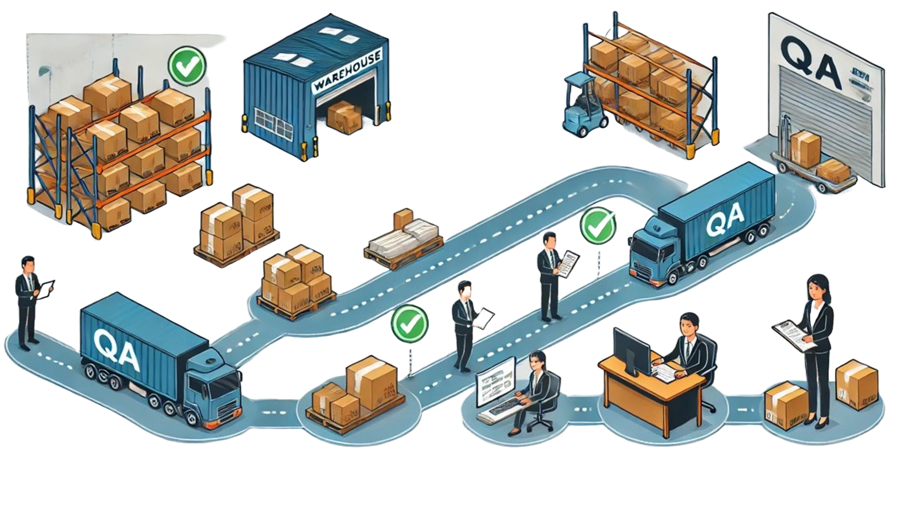


User Journey
step1
step2
step3
step4
Step 1
Step 2
Step 3
Step 4
QA receiving goods at the dock
QA bring goods to office to manually check items against excel sheet and paper documentations
QA key in details in excel
Delivery of goods to customer
(digital) Product Management
ATLAS – Advanced Technology Library for Auto Spares
User Journey
02

Slide 5


Quality Assurance Executive needs to perform quality checks on auto spare parts received from suppliers to ensure the form, fit, and function of the items.​
​
Job-to-be-done
Quality Assurance Executive feels frustrated about doing autospare parts Quality Assurance checks as he constantly has to refer back to Excel sheets to check multiple individual spare parts but cannot do so because this method introduces inconsistencies, labour-intensive data entry, and a high risk of human error – resulting in limited traceability, difficulty in consolidating findings, and delays in identifying quality issues.​
​
Problem Statement
(digital) Product Management
ATLAS – Advanced Technology Library for Auto Spares
Problem Statement
03

Slide 6

Statistics
Yes
No
Pain Points Identified
Is your current QA process time-efficient and reliable?
22%
78%
Time consuming manual inspection
→
Reduce time spent on repetitive manual tasks
Is your current process of manual data entry helpful for QA checks?
21%
79%
Difficulty in consolidating findings across multiple spare parts
→
An integrated system to streamline communications and reporting during the inspection process
Do you have time visibility of spare parts data and QA records?
30%
70%
Would a centralized e-Catalogue help speed up parts verification?
89%
11%
Pressure to maintain high standards on accuracy and accountability of spare parts
→
A system that is reliable and can validate parts accurately
Would an automated system help improve accuracy in QA checks?
85%
15%
(digital) Product Management
ATLAS – Advanced Technology Library for Auto Spares
Statistics
04

Slide 7


Hypothesis
If QA executives struggle with manual Excel-based spare parts checks due to inconsistencies, labor-intensive data entry that leads to high risk of human error, then ATLAS will help them streamline inspections and improve inspection accuracy by providing:
Objective
Improve efficiencies in the search due to manual process
Enhance the accuracy of the visual inspection
Key-Results
Improve time required to do quality checks by 50% by implementing a centralized digital system. Current estimate for one item is 20 minutes.
Improve defect detection accuracy by 90% through the implementation of AI-powered image recognition and augmented reality (AR) assistance.
Achieve 100% traceability of all spare part inspections by integrating a digital tracking system.
Reduce return rate by 80%
(digital) Product Management
ATLAS – Advanced Technology Library for Auto Spares
Hypothesis/OKR
05

Slide 8






Unique Value Proposition (UVP)
Our auto spares QA solution uniquely streamlines the quality assurance process by combining industry-specific knowledge about the auto-spare parts with an intuitive, integrated interface that eliminates manual visual errors and accelerates inspections.
Competitive
Positioning
Defensibility
Niche focus and specialization
Technical moat
Data moat and proprietary information
(digital) Product Management
ATLAS – Advanced Technology Library for Auto Spares
Competitive Positioning
06

Slide 9
Product Roadmap
Weeks 1 - 5
Weeks 6 - 12
Weeks 13 - 20
Weeks 21 - 32
Phase I: Research & Validation
Phase II: Prototype Development
Phase III: Pre-Market Pilot
Phase IV: Full Deployment & Scaling
User Research
More than 70% of QA teams feedback difficulty in quality check processes.
Competitive Gap
Existing barcode systems lack real-time error detection
AI Model
Initial training on 1000 spare part images for error detection
Prototype UI
Workflow, real-time-alerts, and inventory integration
User Testing and Feedback
10+ QA personnel, feedback-led UI/AI refinements
Compliance
Data security & industry regulation checks
Go-To-Market
Onboard QA teams, integrate with ERP systems
AI Learning
Real-time monitoring, model refinement
Milestone
Validated problem statement, competitive analysis and user insights
Milestone
Functional prototype with AI-powered verification
Milestone
Optimized AI accuracy & efficiency proven in pilot
Milestone
80% returns reduction, 50% faster verification, possible company-wide adoption
Business Impact
80% fewer errors in spare part acceptance
50% reduction in manual verification time
5-10% operational cost savings
(digital) Product Management
ATLAS – Advanced Technology Library for Auto Spares
Product Roadmap
07

Slide 10
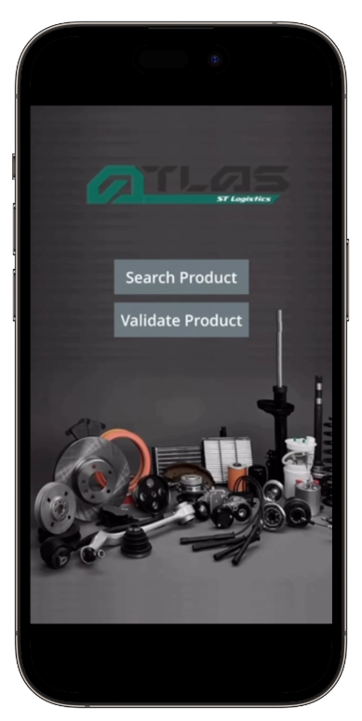

Prototype
Prototype Demo: YouTube - ATLAS - 1st Iteration​
(digital) Product Management
ATLAS – Advanced Technology Library for Auto Spares
1st Iteration
08
Notes:
Link to video: https://youtu.be/XcAJi3uF1UI

Slide 11


Insights from User Reviews
Prototype – 1st iteration
Feature 1
User wants to catalogue items so that quality assurance work is covered end-to-end
Feature 2
User wants to identify items that are rejected by customer, passed, failed internal checks so that they won't mistakenly validate the items
“I still had to walk from warehouse to my desk in office to catalogue new items”
Feature 3
User wants to be able to add comments so that other quality assurance executives can conveniently check on latest updates of the item
“I recall someone telling me this item was rejected, but it still showed up in Search”
(digital) Product Management
ATLAS – Advanced Technology Library for Auto Spares
User Review
09
Notes:
So Kathy went back to her QA executives and got some insightful conversations from the feedbacks and this was helpful that we did not make any assumptions of features we think might help them.
The first being that they still had to walk from warehouse to desk in the office to catalogue, distance travelled. so this takes time and doesn’t really shave off any minutes per item checked.
So from that piece of discussion, the user story we got was that they want to catalogue items so QA work is covered end-to-end.
Another one would be they recall someone telling that the item was rejected, but it still showed up in Search” so from that, we asked what would help and the 2 features were user wants to identify item status
And user wants to add comments so other QA executives can check on latest updates of the item.

Slide 12
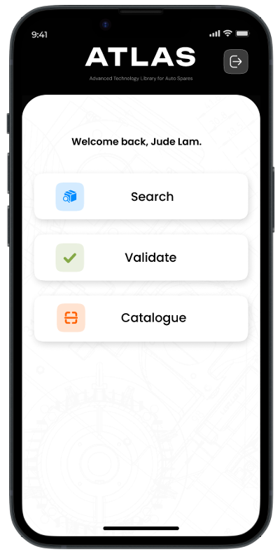


Prototype
2nd iteration | User Insights
Product Prototype: Figma
User Insights
Business Impact
Provided color to checks - images not black and white like on excel sheets
No more walking from desk to warehouse with bulky documents
AI assistance improved
accuracy – lessen load on burden of human accuracy
Saving around 10 – 13 minutes per item check leading to more items checked per hour
Lesser customer returns → enhance brand credibility → potential upside financial returns
(digital) Product Management
ATLAS – Advanced Technology Library for Auto Spares
2nd Iteration
10
Notes:
FIgma allows walkthrough, link: https://www.figma.com/proto/bkt9SBLA7Mr7YLZPOSvYFZ/ATLAS-APP?node-id=7-624&starting-point-node-id=19%3A1399
So for our second prototype we just used Figma due to time constraints.
-Able to walkthrough with user to see how they interact although it is mostly just clicking and swiping.
Search
One slight issue we had in the first iteration is that users have to scroll through the whole screen to look at the images. Now they can flip through horizontally while maintaining most information in one screen which reduces scroll fatigue.
Validate
Incase missed video, it shows the top 3 results in percentages, and they can double check the item information.
Catalogue
Take 6 images from different angles
Enter description
Uploaded to AI library to check for duplicates before being available in AI library
The combined positive user feedback we got -

Slide 13


Challenges
Constructing the Problem Statement
Developing the Prototype
Accurately identify the persona
Accuracy of computer vision algorithm
Objective-Key Results
Clear focus for product development
Agile - User Stories
Enhance clarity of requirement
Usability Heuristics
Familiar - Recognition
Aesthetic and Minimalist Design
Key Concepts
(digital) Product Management
ATLAS – Advanced Technology Library for Auto Spares
Challenges and Key Concepts
11
Notes:
Identifying the right persona so that we don’t end up creating a product that’s too ambitious with features not needed and doesn’t exactly hit the target
Familiar – Carousell, Shopee, Instagram – reducing scroll fatigue
Aesthetic Minimalist – interesting to see if such design helps with productivity in technical users

Slide 14

thank you.

